Slide 1
What Every Data Scientist Should Know About Education
Notes:
Welcome to RStudio instructor training.
Estimated time: 10 minutes.
All art from openclipart.org (open license)

Slide 2
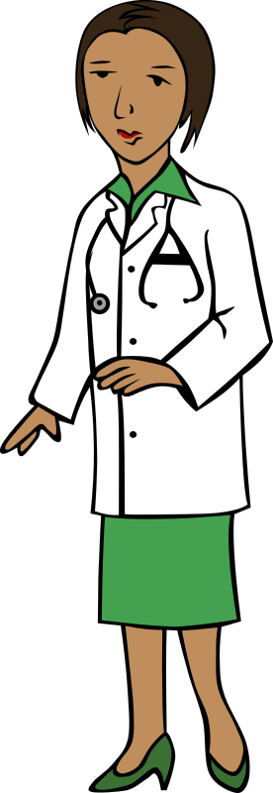

The Pitch
Notes:
We know as much about teaching and learning as we do about public health.

Slide 3


The Pitch
Notes:
The problem is, most programmers don’t know what we know.

Slide 4

The Pitch
Notes:
And neither do a lot of university professors.

Slide 5

The Pitch
Build more effective lessons
In less time and with less effort
That are easier for peers to find and reuse
And know what impact they’re having
Notes:
It turns out that knowing just a few basic facts will help you build more effective lessons in less time and with less effort that are easier for your peers to find and reuse and know what impact those lessons are having on learners.

Slide 6

Starting Point
Notes:
Our key insight is that learning is both a cognitive and a social activity. Learning occurs when your brain stores facts and procedures in ways that allow you to recall and apply what you need when you need it. It also occurs in a social setting: you learn for reasons, with other people, and your goals, motivations, and criteria for success are determined with them and by them. Our other key insight is that both teaching and learning must be active: a teacher reciting a lesson to a learner who simply listens is provably less effective than engagement on both sides.

Slide 7
Step 1: Learner Personas

Slide 8

Meet Jeri: General Background
Born and raised in Trinidad
Moved to Canada to do a PhD in genetics
Enjoys skating, but still doesn’t like the cold
Notes:
This is Jeri’s general background - just a few facts that help to personalize her.

Slide 9
Meet Jeri: Starting Point
Has been analyzing data with Excel for almost ten years
Did an intensive one-day workshop in R at a conference
Tried to learn Git on her own once, found it frustrating
Notes:
This is where Jeri is now. It’s not a list of keywords, because a phrase like “basic knowledge of R” means very different things to different people. Instead, it’s written as a description of a particular person, and we trust the reader to interpolate all the information that isn’t there.

Slide 10
Meet Jeri: Needs
Is going to run 300 experiments in the next six months
Doesn’t want to have to do all the analyses by hand
And wants nicer charts for her thesis than she can produce in Excel
Notes:
This is what Jeri thinks she wants to learn. The most important thing about this list is that it’s written from her point of view: it is what you, the more knowledgeable instructor, might know she needs; it’s what she, with the knowledge she has right now, is searching for.

Slide 11
Meet Jeri: Special Considerations
Very uncomfortable speaking in front of groups
Notes:
The final part of the persona describes anything else that ought to be taken into consideration. Are they hard of hearing? Do they need to be away at 4:00 pm for childcare or elder care? Are they going to be using a locked-down machine that won’t let them install software packages? Any one of these things could throw your teaching off track, so it’s best to think about them up front.

Slide 12
Meet Jeri: How You Can Help
“This one-week hands-on introduction to the tidyverse will show learners how to load, clean, explore, visualize, and analyze tabular data in a reproducible way.”
Notes:
The fourth part of the persona isn’t about the person. It explains how your training is going to help them meet their needs, in a way that they can understand. It’s the one-line entry in the course catalog that will catch their eye and help them figure out whether your training is right for them.

Slide 13

Multiple Personas
General background
Relevant experience
Their perceived needs
Special considerations
Notes:
What we just created is called a learner persona. Anyone who teachers, or any group that teaches together, should create a handful of these that describe the range of learners they’re trying to help. Personas will remind you of one of the most important rules of teaching: you are not your learners.

Slide 14
Step 2: Mental Models

Slide 15
A
B
C
E
D
F
Novice
Notes:
Neural networks don’t map directly to concept maps, but wiring helps explain the differences between novices, competent practitioners, and experts. Novices don’t have a lot of connections between concepts.

Slide 16
A
B
A
B
C
C
E
E
D
D
F
F
Novice
Competent
Notes:
Competent practitioners have more, but it can take them several steps to get from what they know to what they need.

Slide 17
A
B
A
B
A
B
C
C
C
E
E
E
D
D
D
F
F
F
Novice
Competent
Expert
Notes:
Experts have many more connections, so their path is shorter—so short, in fact, that they can often jump from start to finish in a single step. This is also what leads to expert blind spot: they can’t explain their reasoning because there isn’t any.

Slide 18
Symptoms
Do things by rote
Ask nonsensical questions
Use the wrong terms
Can’t tell what’s relevant
Lack of confidence
Notes:
A lack of confidence doesn’t necessarily mean that someone is a novice.

Slide 19
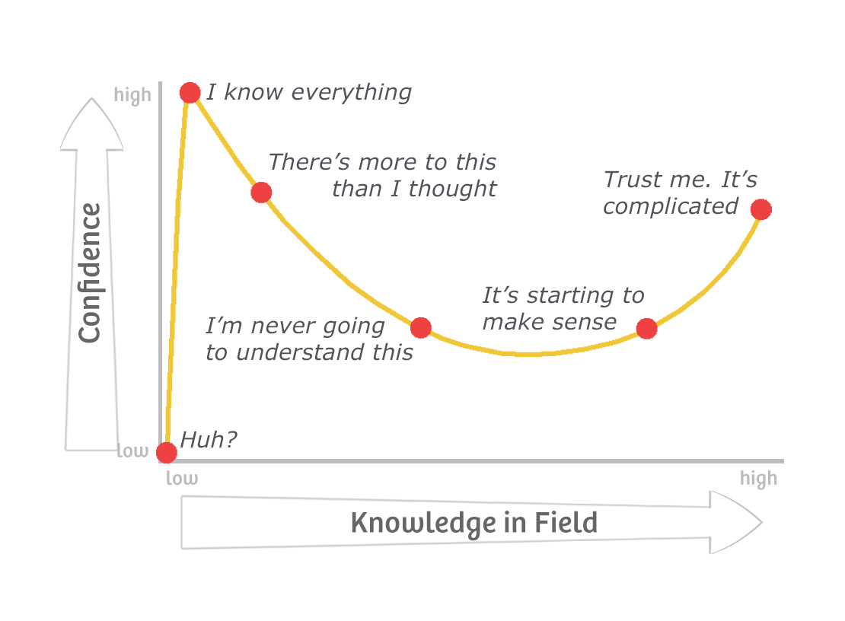
Symptoms
Do things by rote
Ask nonsensical questions
Use the wrong terms
Can’t tell what’s relevant
Lack of confidence
Notes:
More importantly, being confident is no guide to expertise because of something called the Dunning-Kruger Effect. People from privileged groups are particularly susceptible to it, which is something we’ll return to later.

Slide 20
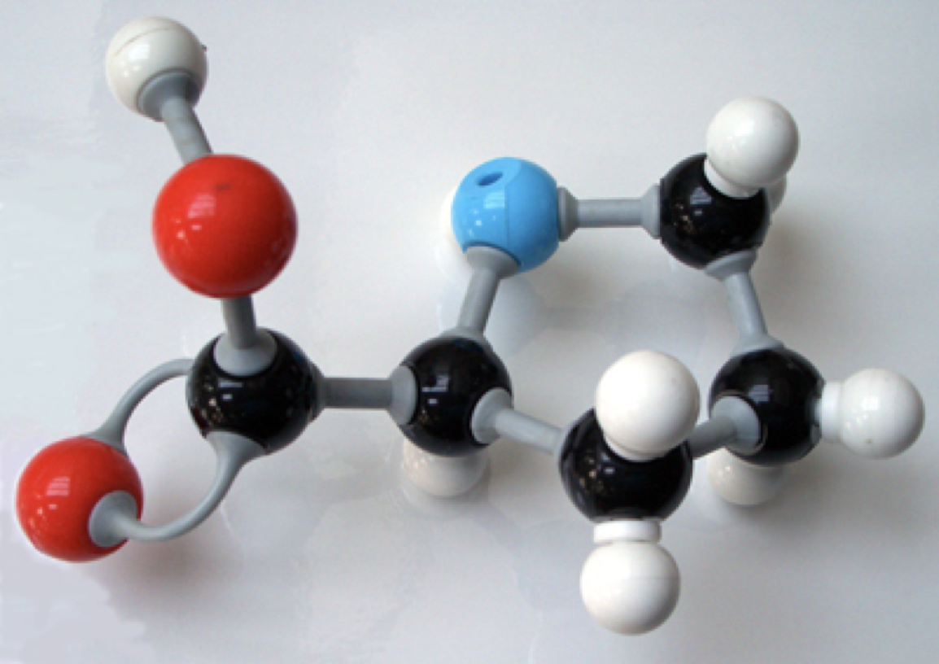
A Mental Model
Notes:
Here’s an example of what we mean by a mental model. In grade school science class, you were probably taught that atoms are brightly colored balls connected by springs. None of those things are actually true, but it’s a useful model for understanding the things people want to understand at that stage of their development, and for solving the problems they want to solve.

Slide 21
Another Mental Model
CPU
RAM
hard drive
Notes:
Here’s another mental model: a computer has a CPU, some RAM, and a hard drive. It’s really useful for explaining computer performance to novices…

Slide 22
Another Mental Model
CPU
nope
RAM
nope
hard drive
nope
Notes:
…but again, everything about it is untrue. Your computer probably has several processors, there are at least three levels of memory, and your hard drive probably isn’t a drive. None of that matters to most programmers, though: the model allows them to make predictions that they can act on and to fix things that go wrong.

Slide 23
Concept Map
photosynthesis
produces
occurs in
requires
glucose
chloroplasts
absorb
oxygen
CO₂
water
stores
released to
light
absorbed from
energy
air
Notes:
Here’s one possible concept map for photosynthesis. Yours could be very different: you might emphasize different elements, or be thinking about it from the point of view of a different audience. What this does is externalize cognition: it puts your thinking out in the open where other people (and you) can see it.

Slide 24
Step 4: Formative Assessment

Slide 25

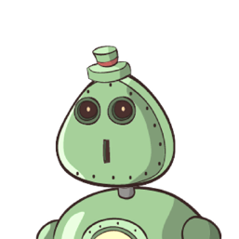
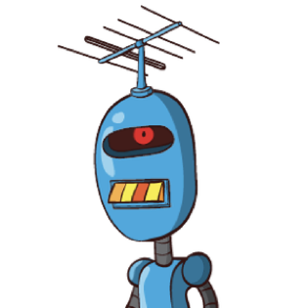
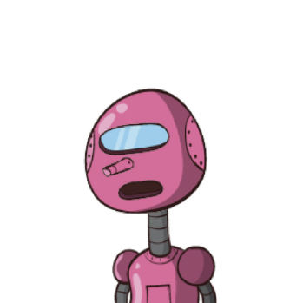
What Is 37 + 15 ?
52
412
42
43
Notes:
To see how to do this, let’s imagine we’re teaching some children how to do multi-digit addition, and we ask them to add 37 and 15.

Slide 26
What Is 37 + 15 ?
52
Correct
Notes:
If they say “52”, then either they understand how to do it or they’ve made a lucky guess.

Slide 27
What Is 37 + 15 ?
Didn’t carry
42
Notes:
If they got “42”, they probably didn’t carry. In fact, they probably wrote down “12” as the sum of 7 and 5, and then added 3 and 1 to get 4 and wrote that on top of the “1” from “12”.

Slide 28
What Is 37 + 15 ?
Added columns separately
412
Notes:
What if they got 412? In this case, they still don’t understand how to carry, but it’s a step forward: they’re keeping the 1.

Slide 29
What Is 37 + 15 ?
Carried into the same column
43
Notes:
And what about 43? This child has almost got it: they’ve carried the 1, but they’ve carried it back into the 1’s column because they don’t understand it’s a 10.

Slide 30
Diagnosing Misconceptions
Notes:
Each of the learners who gave a wrong answer has a different misconception. Each one therefore needs a different explanation to move forward. It might be a linear progression or it might not; what’s important is that if you don’t understand what they don’t understand, you’re just guessing about what to say next.

Slide 31
Formative Assessment
Quick (1-2 minutes)
Unambiguous (scalable)
Diagnostic power
“Can I move on?”
Notes:
They tell instructors whether they can move on or not (and if not, why not).

Slide 32
Formative Assessment
Quick (1-2 minutes)
Unambiguous (scalable)
Diagnostic power
“Do I understand this?”
Notes:
And they give learners a way to check that they actually understand something (because it’s easy to believe you do until you try to use knowledge).

Slide 33
Reverse Instructional Design
learner personas
concept map
Step 3
lesson
formative assessment
Notes:
This style of lesson development was invented independently at least three times, and has several names—we like to call it reverse instructional design. There’s still one component we need to add to complete the picture, though.

Slide 34
Summative Assessment
learner personas
concept map
summative assessment
lesson
formative assessment
Notes:
That missing component is called summative assessment. It’s like a driving exam—its purpose is to tell you if the learner has mastered the material and is ready to go out on their own.

Slide 35
Summative Assessment
formative assessment
formative assessment
summative assessment
formative assessment
Notes:
One reason to create the summative assessment at this stage is that it helps you figure out what formative assessments you need. Your learners should have a chance to practice everything they’re going to do in the summative assessment before they do it. Breaking that final assessment down into component skills tells you what formative assessments you need; figuring out their dependencies tells you the order in which you should use them.

Slide 36
What’s Going On In There?

Slide 37
Unequal Weights
encode
verbal channel
ears
speech
∬
visual channel
eyes
images
retrieve
long-term memory
short-term memory
Notes:
As we’ve drawn it so far, this diagram gives equal weight to the verbal and visual channels. In reality, most people get far more information, far more quickly, through their visual channel.

Slide 38
Unequal Weights
 | Information | Neurons
Vision | 83% | 30%
Hearing | 11% | 2%
Smell | 3.5% | 8%
Touch | 1.5%
Taste | 1%
Notes:
There’s obviously a lot of variation between people, and our learner personas should remind us that not everyone can see and hear equally, but these figures give you an idea of how much information we get from different senses and how much of our brain is devoted to processing and storing it. What this tells us is that in most cases, our lessons should be as visual as possible.

Slide 39
Bottleneck
7 ± 2
Notes:
But short-term memory is a serious cognitive bottleneck. Estimates in the 1950s were that it could hold 7±2 items; more recent estimates put the number closer to 4.

Slide 40
Count Them All
photosynthesis
produces
occurs in
requires
glucose
chloroplasts
absorb
oxygen
CO₂
water
stores
released to
light
absorbed from
energy
air
Notes:
This concept map has nineteen things in it. That’s too many, so part of the craft of designing a lesson is to break it into chunks guided by the formative assessments we can do.

Slide 41
Count Them All
photosynthesis
produces
occurs in
requires
glucose
chloroplasts
absorb
oxygen
CO₂
water
stores
released to
light
absorbed from
energy
air
Notes:
Here’s one digestible chunk.

Slide 42
Count Them All
photosynthesis
produces
occurs in
requires
glucose
chloroplasts
absorb
oxygen
CO₂
water
stores
released to
light
absorbed from
energy
air
Notes:
And here’s another. We’re using the concept map to guide our choice of chunk size as well as subgoals.

Slide 43
It’s Not Just About Brains

Slide 44
Motivation
Intrinsic | Doing this for my own reasons
Extrinsic | Doing this because I have to
Notes:
The single strongest predictor of whether an adult learns something or not is their motivation, and any discussion of motivation has to start with the difference between intrinsic and extrinsic motivation. Learning to play the ukulele because you’ve always wanted to is intrinsic; learning because you’re in Grade 5 and the teacher said so is extrinsic, and unlikely to stick.

Slide 45
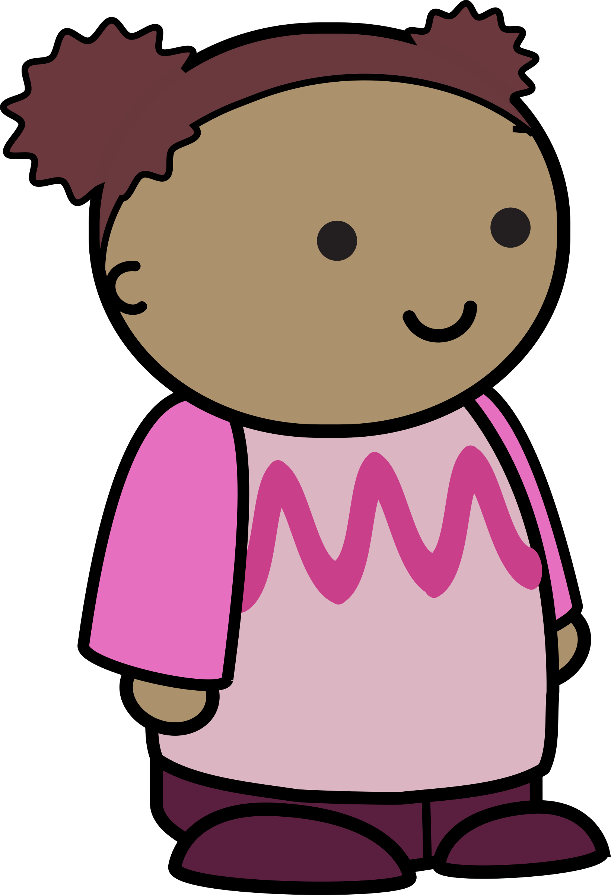
Positive: Self-Efficacy
I am in control of my own life.
Notes:
First and most importantly, adults want to be in control of their own lives - they don’t like to jump through hoops. Self-efficacy is the driving force behind self-paced online training: it allows people (well, those privileged enough to have free time) to learn what they want and when they want.

Slide 46
Positive: Utility
This will help me meet my goals.
Notes:
Utility is the second big motivator for adults. Is this useful? Will it help me meet my goals? (It’s important to note that there are many kinds of utility, just as people have many different kinds of goals—learning the ukulele probably won’t help you find a job, but that’s not why you’re doing it.)

Slide 47
Positive: Community
People I know are learning this with me.
Notes:
The third motivator is community. People like to do what their friends, neighbors, and colleagues are doing, and they like to do things together - this is why the best predictor of whether someone actually uses a gym membership is whether or not someone they know is going with them.

Slide 48
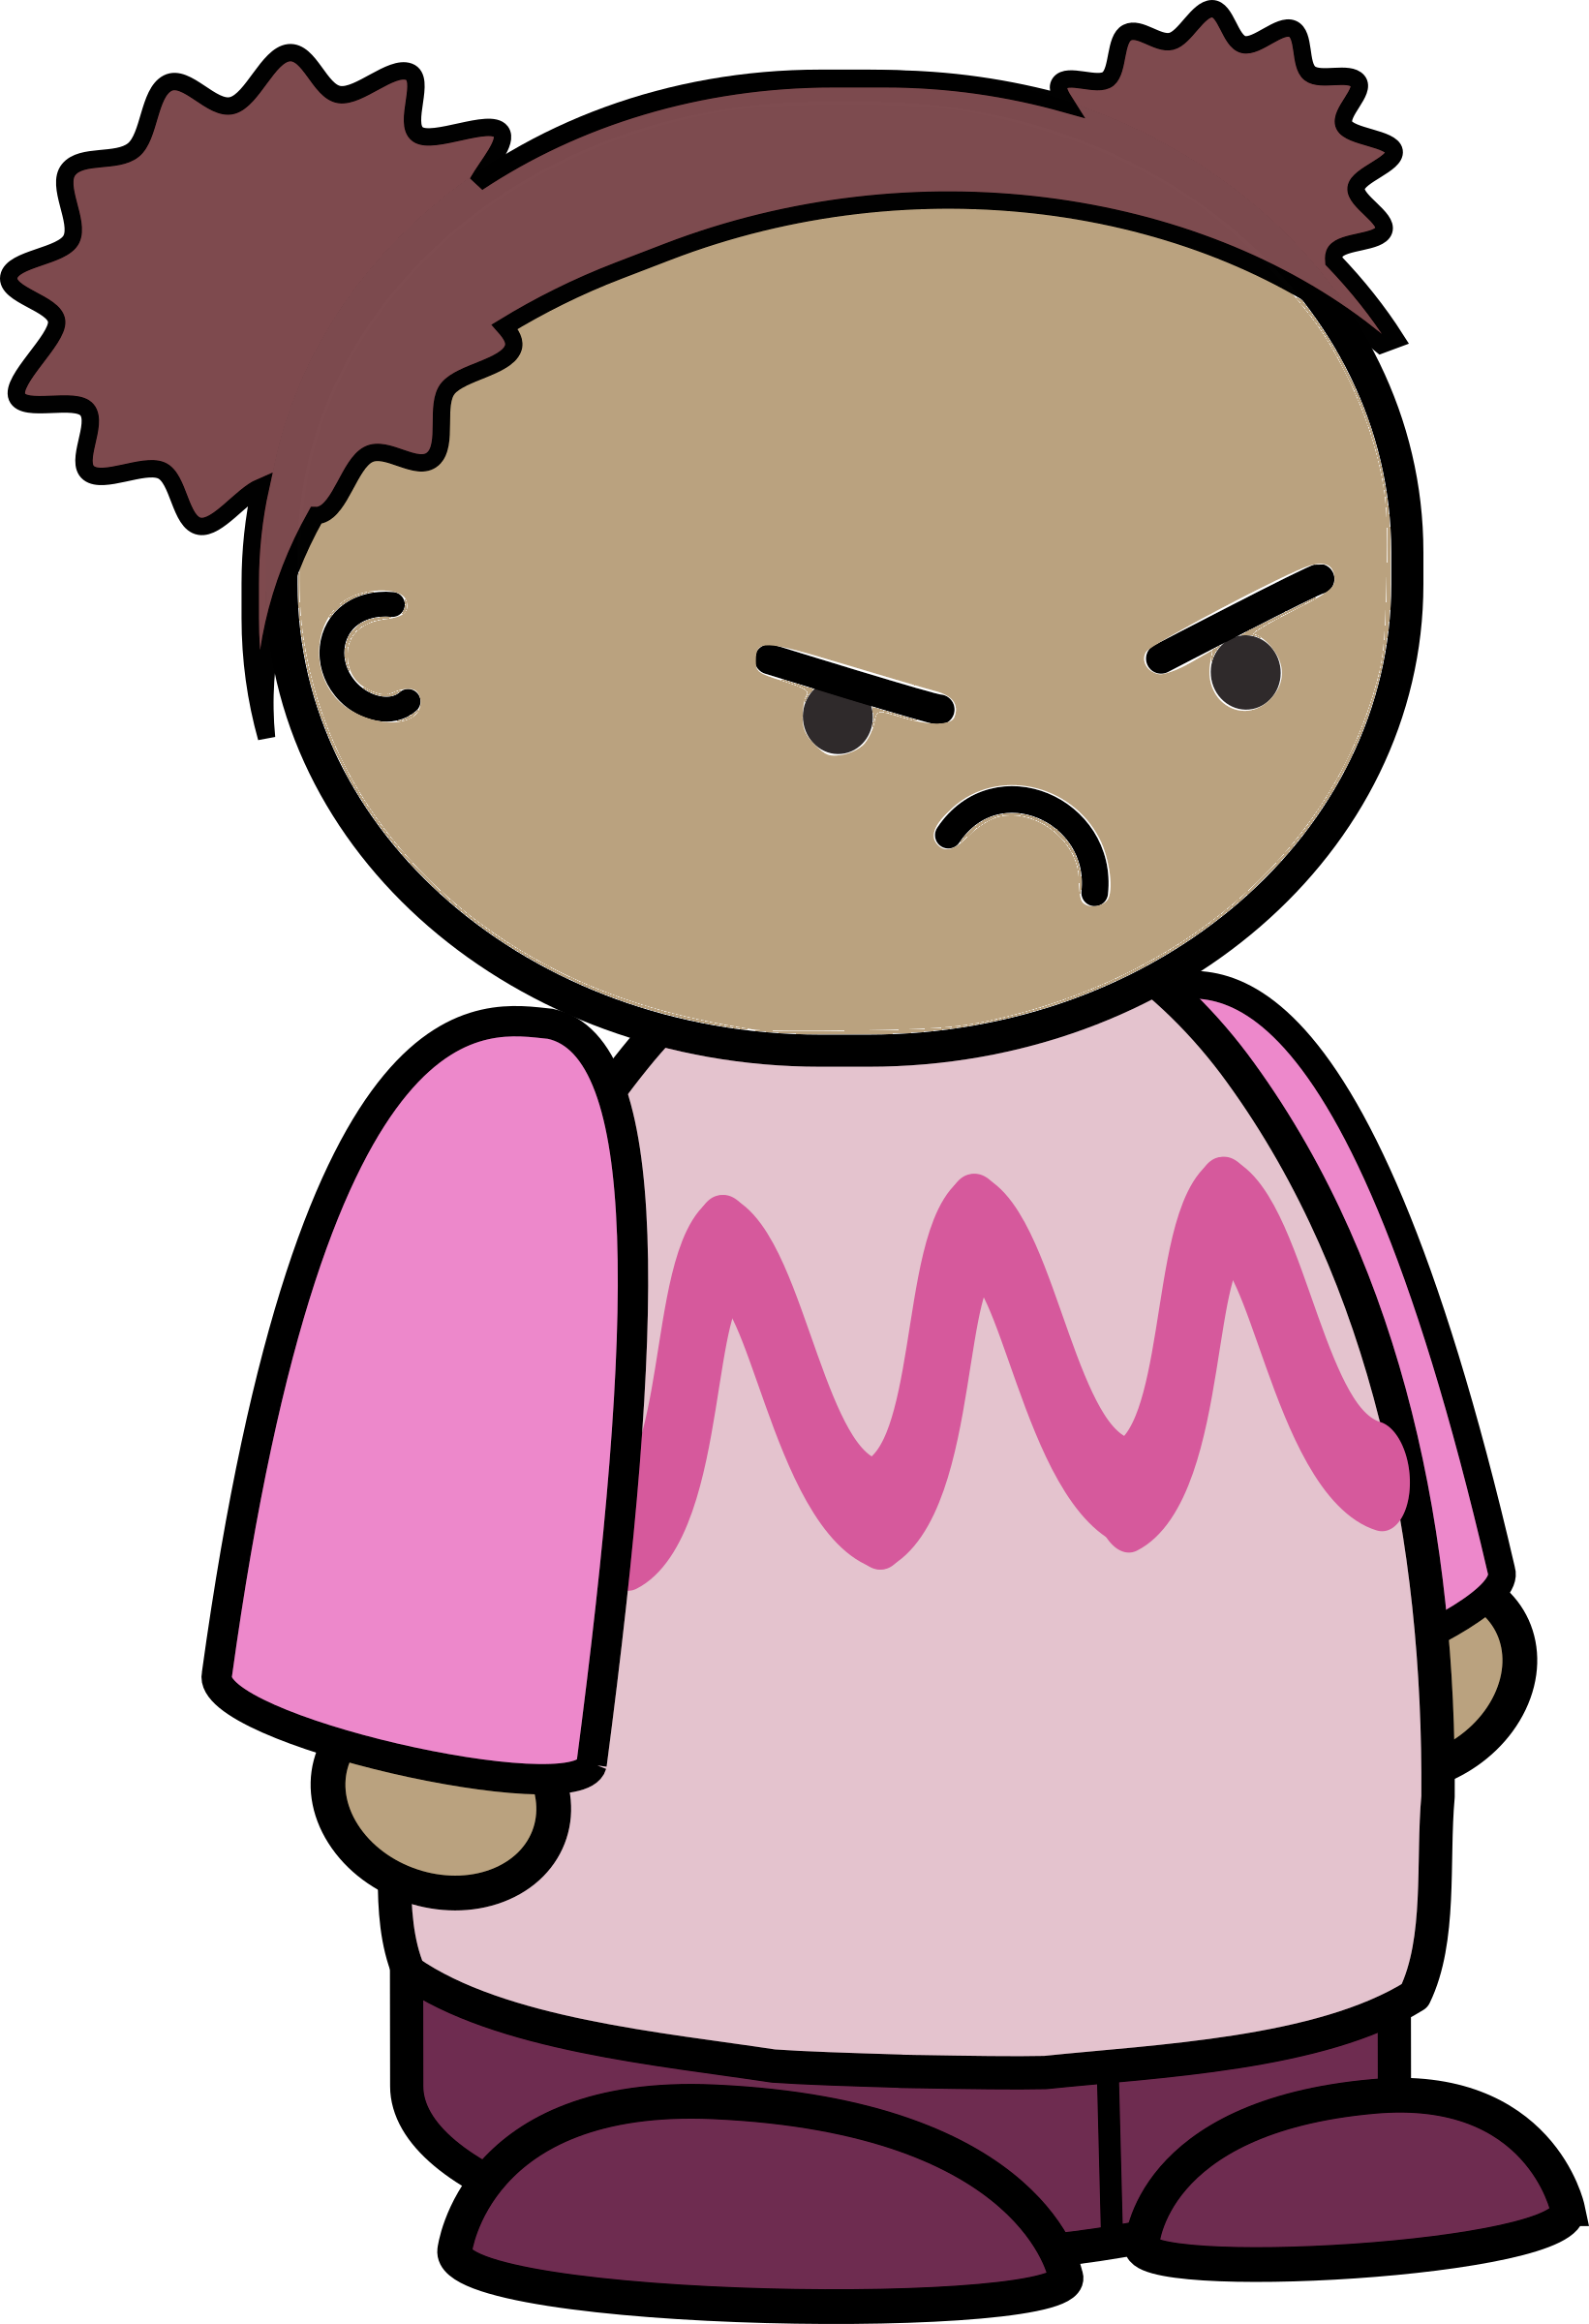
Negative: Unpredictability
What I do doesn’t seem to affect the outcome.
Notes:
Now let’s look at demotivators. The most important is unpredictability: if taking actions works some of the time, but not other times, people give up trying because there’s no point. This is called learned helplessness.

Slide 49
Negative: Unfairness
The teacher plays favorites.
Notes:
A second big demotivator is unfairness. Studies have shown that if people believe the game is rigged, everyone will do less well—even those that the game is rigged in favor of.

Slide 50
Negative: Indifference
Nobody cares.
Notes:
The third of our demotivators is indifference—the feeling that nobody cares if you succeed or not. It’s easy for students to feel this way in large classes or when learning online, but it’s also easy for instructors to give this impression even when they’re teaching one-to-one.

Slide 51
Not Just in Class
If poor inner-city children consistently outscored children from wealthy suburban homes on standardized tests, is anyone naive enough to believe that we would still insist on using these tests as indicators of success?
– Kenneth Wesson
Notes:
Unfairness and indifference aren’t restricted to class. As Sahlberg and others have pointed out, one of the reasons other countries have failed to replicate Finland’s very successful school system is that they’re not willing to address all of the out-of-school factors that determine whether learners are willing and able to succeed.

Slide 52

The Most Important Thing
Don’t use a deficit model
Notes:
The most important thing, though, is not to use a deficit model to think about fairness. Don’t say that “they” have to lean in or that “they” need special support: that implies that the people who are the victims of unfairness ought to do extra work to overcome or eliminate that unfairness.

Slide 53
The Most Important Thing
Don’t use a deficit model
https://frameshiftconsulting.com/ally-skills-workshop/
Notes:
The most important thing, though, is not to use a deficit model to think about fairness. Don’t say that “they” have to lean in or that “they” need special support: that implies that the people who are the victims of unfairness ought to do extra work to overcome or eliminate that unfairness.

Slide 54
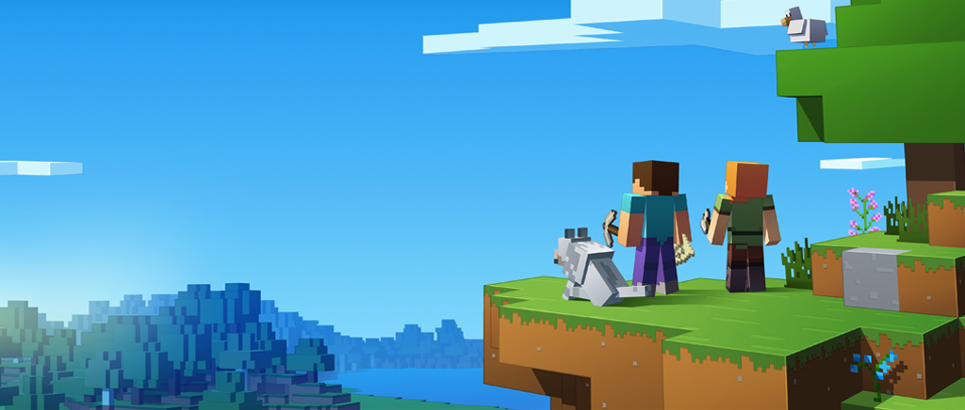
What Next?
Notes:
Critics sometimes say that online education is what everybody wants for somebody else’s children. The data backs that up: while they can be effective for some learners in some situations, MOOCs still have very low completion rates, are often pedagogically ineffective, and can increase learners’ feeling of isolation. But that doesn’t mean that all online education is a bad idea. Synchronous online collaboration is now normal for children, gamers, and office workers. It’s easy to imagine a world in which video conferencing tools support peer instruction, and in which sharing your programming session with the rest of the class is as routine as sharing a picture of your cat.

Slide 55
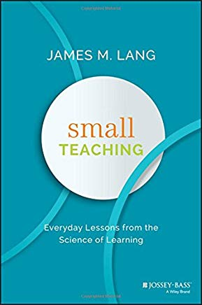

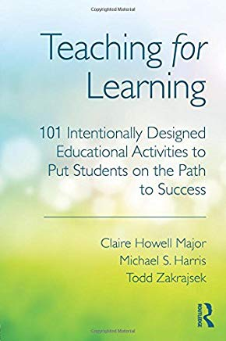
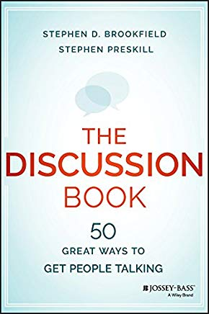


Where Next?
Notes:
Here are a few places to go next if you’d like to learn more.

Slide 56
Where Next?
http://teachtogether.tech
Notes:
Teaching Tech Together is a work in progress that tries to bring key elements of theory and practice together for people with technical backgrounds who find themselves teaching in free-range settings. All of its content is freely available online.

Slide 57
Thank You
Be kind: all else is details.
Remember that you are not your learners…
…that most people would rather fail than change…
…and that ninety percent of magic consists of knowing one extra thing.
Never teach alone.
Never hesitate to sacrifice truth for clarity.
Make every mistake a lesson.
Remember that no lesson survives first contact with learners…
…that every lesson is too short for the teacher and too long for the learner…
…and that nobody will be more excited about the lesson than you are.
Notes:
These ten rules are not the whole of teaching, but they’re a pretty good start.
Thank you for listening.

